Slide 1

Java EE:
Servlets API 4.0
SoftUni Team
Technical Trainers
Software University
http://softuni.bg

Slide 2
Table of Contents
Servlet API 4.0
Tasks
Lifecycle
Architecture
Hibernate
HTTP Sessions

Slide 3
Questions
sli.do #java-web

Slide 4

Java Servlets
Overview

Slide 5


What are Servlets?(1)
Servlets:
Component-based
Platform-independent
Method for building Web based applications
Have access to the entire family of Java APIs

Slide 6

What are Servlets?(2)
Java Servlets:
Programs that run on a Web or Application server
Middle layer between a requests
Servlets can:
Collect input
Present records from a database or another source
Create web pages dynamically

Slide 7
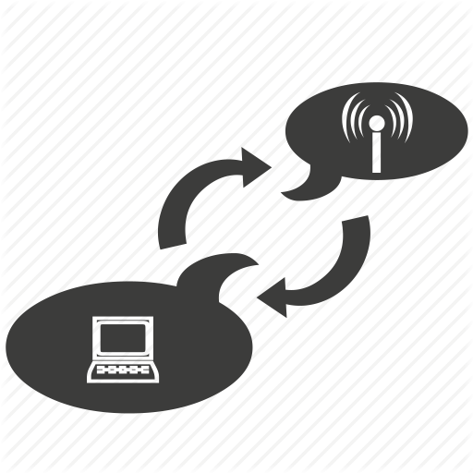
Servlets Tasks(1)
Read the explicit data sent by the clients (browsers):
HTML form on a Web page
Applet
Custom HTTP client program

Slide 8
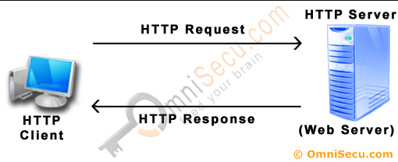
Servlets Tasks(2)
Read the implicit HTTP request data sent by the clients
(browsers):
Cookies
Media types
Compression schemes the browser understands

Slide 9
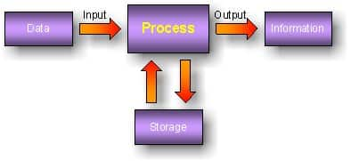
Servlets Tasks(3)
Process the data and generate the results:
Talking to a database
Invoking a Web service
Computing the response directly

Slide 10
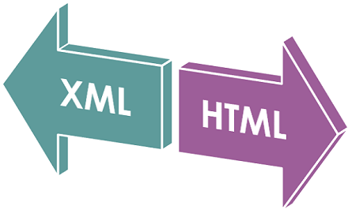


Servlets Tasks(4)
Send the explicit data to the clients (browsers):
Text (HTML or XML)
Binary (GIF images)
Excel

Slide 11

Servlets Tasks(5)
Send the implicit HTTP response to the clients (browsers):
Telling the browsers or other clients what type of document is
being returned (e.g., HTML)
Setting cookies
Caching parameters

Slide 12
Servlet Life Cycle
A servlet life cycle:
init() method – initialize servlet
service() method - process client's request
destroy() method - servlet is terminated

Slide 13

The init() Method
The init() method:
Called only once when the servlet is created
Servlet is created when a user first invokes a URL corresponding to the servlet

Slide 14
The service() Method
The service() method:
The main method to perform the actual task
Called by the servlet container to:
Handle requests coming from the client
Write response back to the client
Checks the HTTP request type (GET, POST, PUT, DELETE, etc.) and calls the appropriate method – doGet(), doPost(), etc.

Slide 15
The doGet() Method
A GET request:
Results from:
Normal request for a URL
HTML form that has no METHOD specified
Should be handled by doGet() method
Servlet.java
@WebServlet("/")
public class Servlet extends HttpServlet {
protected void doGet(…) {
// Servlet code
}
}

Slide 16
The doPost() Method
A POST request:
Results from an HTML form
Should be handled by doPost() method.
Servlet.java
@WebServlet("/")
public class Servlet extends HttpServlet {
protected void doPost(…) {
// Servlet code
}
}

Slide 17

The destroy() Method
The destroy() method:
Called only once at the end of the lifecycle of a servlet
Gives your servlet chance to:
Close database connections
Halt background threads
Write cookie lists
Hit counts to disk
Perform other such cleanup activities

Slide 18
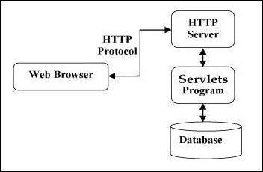
Servlets Architecture
The following diagram shows the position of Servlets in a Web Application:

Slide 19
Java Servlets
Examples

Slide 20
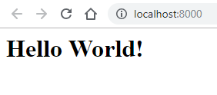
Hello World!
Servlet.java
@WebServlet("/")
public class Servlet extends HttpServlet {
private String message;
protected void init(…) {
this.message = “Hello World!”;
}
protected void doGet(…) {
response.setContentType(“text/html”);
PrintWriter out = response.getWriter();
out.println(String.format(“<h1>%s</h1>”, this.message));
}
}

Slide 21
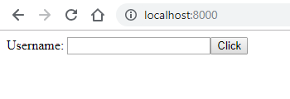
Greeting!(1)
FormServlet.java
@WebServlet("/")
public class FormServlet extends HttpServlet {
private String form;
protected void init(…) {
this.form = "" +
"<form action=\"/greeting\" method=\"post\">" +
"<label>Username: " +
"<input name=\"username\"/></label>" +
"<button>Click</button>" +
"</form>";
}
protected void doGet(…) {
response.setContentType(“text/html”);
PrintWriter out = response.getWriter();
out.println(this.form);
}
}

Slide 22
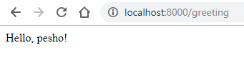
Greeting!(2)
GreetingServlet.java
@WebServlet("/greeting")
public class GreetingServlet extends HttpServlet {
protected void doGet(…) {
response.setContentType(“text/html”);
response.setStatus(200);
}
protected void doPost(…) {
response.setContentType(“text/html”);
PrintWriter out = response.getWriter();
out.println(String.format("Hello, %s!", request.getParameter("username")));
}
}

Slide 23

Hibernate
Overview

Slide 24

What is JDBC?
JDBC:
Java Database Connectivity
Provides a set of Java API for accessing the relational databases from Java program
Enables Java programs to:
Execute SQL statements
Interact with any SQL compliant database

Slide 25
What is Hibernate?(1)
Hibernate:
Object-Relational Mapping (ORM) solution for Java
Powerful
High performance
Object-Relational Persistence
Query service
Maps:
Java classes to database tables
Java data types to SQL data types

Slide 26
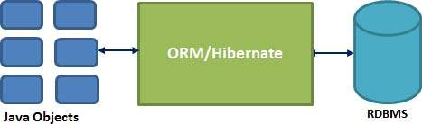
What is Hibernate?(2)
Hibernate:
Sits between traditional Java objects and database server
Handles all the works in persisting objects based on the
appropriate O/R mechanisms and patterns

Slide 27
Java EE and Hibernate(1)
Hibernate dependency:
Hibernate .jar file: http://central.maven.org/maven2/org/hibernate/hibernate-core/5.4.4.Final/hibernate-core-5.4.4.Final.jar
Put the .jar file into TomEE/lib folder.
pom.xml
<dependency>
<groupId>org.hibernate</groupId>
<artifactId>hibernate-core</artifactId>
<version>5.4..Final</version>
</dependency>

Slide 28
Java EE and Hibernate(2)
persistence.xml
<?xml version="1.0" encoding="UTF-8"?>
<persistence xmlns:xsi="http://www.w3.org/2001/XMLSchema-instance"
xmlns="http://xmlns.jcp.org/xml/ns/persistence"
xsi:schemaLocation="http://xmlns.jcp.org/xml/ns/persistence http://xmlns.jcp.org/xml/ns/persistence/persistence_2_1.xsd" version="2.1">
<persistence-unit name="soft_uni" transaction-type="RESOURCE_LOCAL">
<properties>
<property name = "hibernate.connection.url" value="jdbc:mysql://localhost:3306/soft_uni_db?useSSL=false&amp;createDatabaseIfNotExist=true&amp;serverTimezone=UTC"/>
<property name = "hibernate.connection.driver_class" value="com.mysql.jdbc.Driver"/>
<property name = "hibernate.connection.username" value="root"/>
<property name = "hibernate.connection.password" value="*****"/>
<property name = "hibernate.dialect" value="org.hibernate.dialect.MariaDBDialect"/>
<property name = "hibernate.hbm2ddl.auto" value="update"/>
<property name = "hibernate.show_sql" value = "true" />
<property name = "hibernate.format_sql" value = "true" />
</properties>
</persistence-unit>
</persistence>

Slide 29

HTTP Sessions

Slide 30


What are Sessions?
A way to store information about a user to be used across multiple pages
/login
Web Application
Session
/home
user: Teo
/products

Slide 31

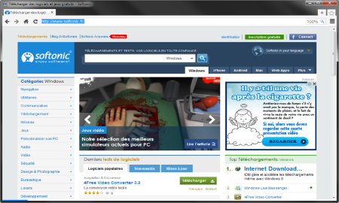



Session Management
The exchange mechanism be used between the user and the web application
First Time Login
Web Client
Web Application
User credentials
Session ID
31

Slide 32
Session Management
The exchange mechanism be used between the user and the web application
Browsing Pages
Web Client
Web Application
Session ID
Requested data + Session ID
32

Slide 33
Session Management
The exchange mechanism be used between the user and the web application
Browsing pages after
the server is restarted
Web Client
Web Application
Session ID
Requested Data + Session ID
33

Slide 34
Relation with Cookies
Session Store
sid 5 { uid: 101 }
sid 7 { uid: 102 }
Cookie {
name: sid value: 5
}
Validate
Req
Web Application
Session
Resp
Database
Cookie {
name: sid value: 7
}
Req
Get data
uid name 101 Teo
102 Bojo
Resp
Create personal web page

Slide 35
Session Structure
"hje85d3" : {
user_id: 789
username: FirstUser
},
"af354dd" : {
user_id: 456
username: SecondUser
},
"fg78e5s" : {
user_id: 654
username: ThirdUser
}
Unique
Session ID
Key-Value pairs with user data

Slide 36




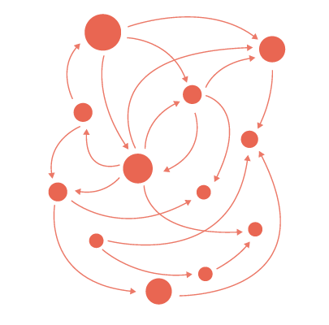
Summary
Java Servlets:
Servlets provide a component-based,
platform-independent method for
building Web based applications
Hibernate:
Hibernate is an Object-Relational
Mapping (ORM) solution for Java

Slide 37
https://softuni.bg/trainings/courses

Slide 38












SoftUni Diamond Partners

Slide 39




SoftUni Organizational Partners

Slide 40




Trainings @ Software University (SoftUni)
Software University – High-Quality Education and Employment Opportunities
softuni.bg
Software University Foundation
http://softuni.foundation/
Software University @ Facebook
facebook.com/SoftwareUniversity
Software University Forums
forum.softuni.bg

Slide 41

License
This course (slides, examples, demos, videos, homework, etc.) is licensed under the "Creative Commons Attribution-NonCommercial-ShareAlike 4.0 International" license

